Slide 1
Hayden preliminary

Slide 2
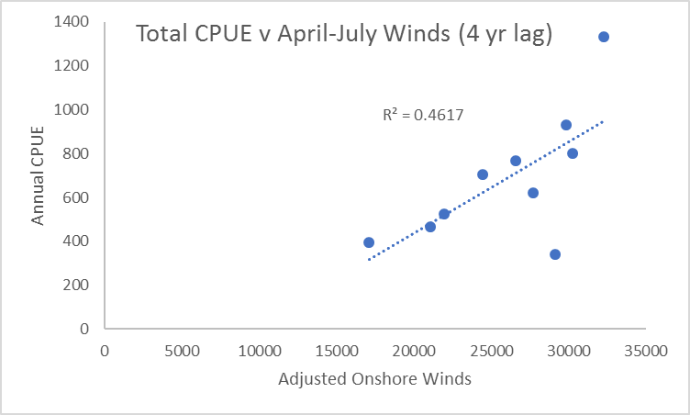
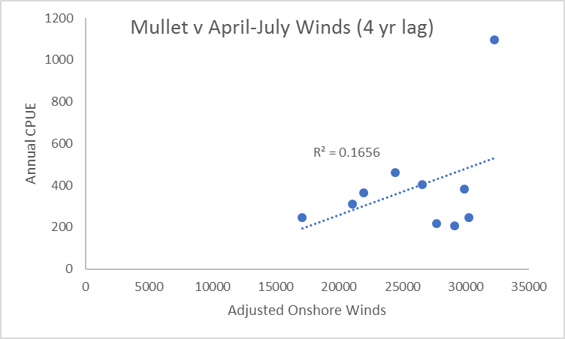
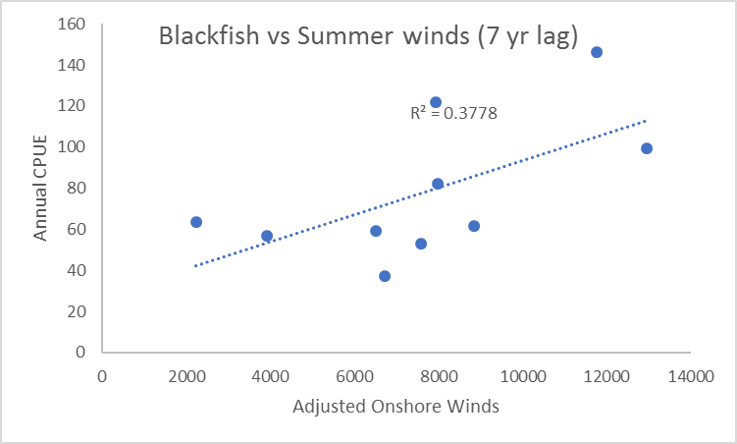
Illawarra

Slide 3
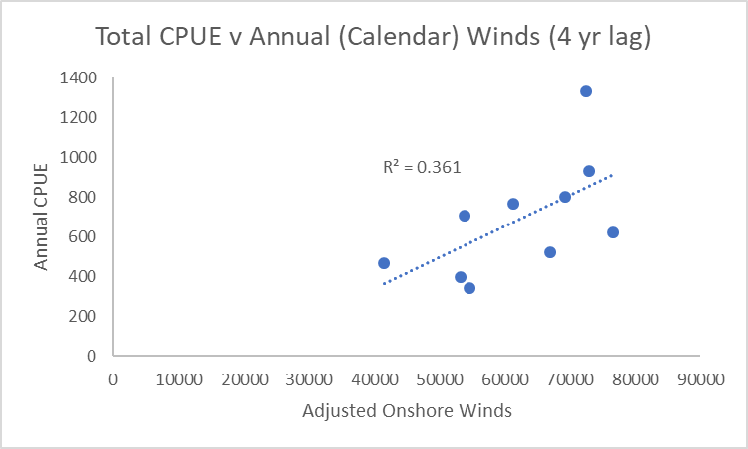
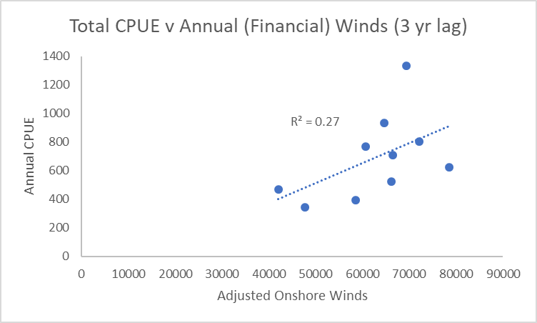
Illawarra

Slide 4
Tuggerah

Slide 5
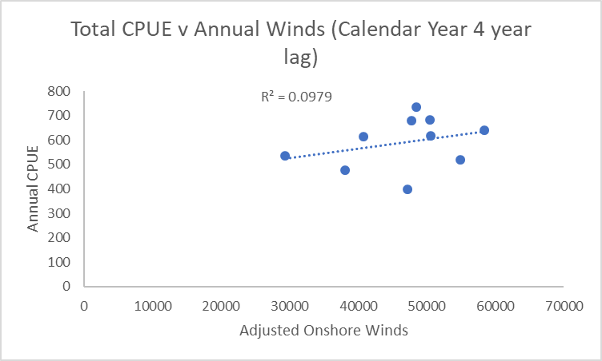

Tuggerah

Slide 6
Against wrong winds - Tuggerah

Slide 7
Against wrong winds - Tuggerah
Tuggerah

Slide 8
Against wrong winds - Illawarra

Slide 9
Against wrong winds - Illawarra

Slide 10
Illawarra:
Tuggerah:
% CPUE | Bream | Dusky flathead | Luderick | Sand whiting | Sea mullet | TotalCPUE
Year | CPUE | CPUE | CPUE | CPUE | CPUE | CPUE
1997 | 5.559649 | 21.09952 | 10.24092 | 1.126543 | 61.97337 | 100
1998 | 5.957014 | 18.16375 | 13.18804 | 0.712236 | 61.97896 | 100
1999 | 4.047378 | 24.29033 | 24.99674 | 1.489927 | 45.17563 | 100
2000 | 5.902207 | 18.89878 | 26.08724 | 0.602542 | 48.50923 | 100
2001 | 3.614621 | 10.93669 | 18.76918 | 1.12231 | 65.5572 | 100
2002 | 10.05806 | 10.48645 | 20.15199 | 1.461763 | 57.84173 | 100
2003 | 23.08517 | 9.131384 | 18.51807 | 2.402641 | 46.86274 | 100
2004 | 8.963044 | 9.304924 | 16.62161 | 2.334858 | 62.77556 | 100
2005 | 9.036338 | 9.609019 | 15.0744 | 0.524227 | 65.75602 | 100
2006 | 21.79328 | 12.35174 | 19.03433 | 0.78758 | 46.03307 | 100
Mean | 9.801676 | 14.42726 | 18.26825 | 1.256463 | 56.24635 | 100
SD | 6.999827 | 5.630047 | 4.876435 | 0.67396 | 8.581311
% CPUE | Bream | Dusky flathead | Luderick | Sand whiting | Sea mullet | TotalCPUE
Year | CPUE | CPUE | CPUE | CPUE | CPUE | CPUE
1997 | 16.19894 | 12.18183 | 9.435612 | 0.203757 | 61.97986 | 100
1998 | 10.9247 | 8.045078 | 11.27501 | 0.356928 | 69.39829 | 100
1999 | 9.612747 | 12.79345 | 16.64034 | 0.977064 | 59.9764 | 100
2000 | 8.247236 | 6.997008 | 17.52508 | 1.107617 | 66.12306 | 100
2001 | 7.761861 | 10.74491 | 14.09408 | 1.996873 | 65.40228 | 100
2002 | 4.106449 | 3.526483 | 9.143925 | 0.95167 | 82.27147 | 100
2003 | 31.4452 | 7.552793 | 6.91681 | 1.407374 | 52.67782 | 100
2004 | 52.69014 | 8.184519 | 7.905059 | 0.764538 | 30.45574 | 100
2005 | 44.35162 | 9.966596 | 9.926692 | 0.725099 | 35.02999 | 100
2006 | 26.98448 | 13.91422 | 15.68884 | 2.204974 | 41.20749 | 100
Mean | 21.23234 | 9.390688 | 11.85514 | 1.069589 | 56.45224 | 100
SD | 16.90314 | 3.140402 | 3.82981 | 0.646035 | 16.43916

Slide 11
